Slide 1
UNSW-NB15 DATA SET
KDD99
Twelve algorithm: Feauture generation
49 feature with class level(divided into 6 groups)
With two million and 540,044 records
Partition(configured main dataset):
Train: 175,341 records
Test: 82,332 records
Attacks type:
Fuzzers
Analysis
Backdoor
DoS
Exploit
Generic
Reconnaissance
Shellcode
Worm
41 extracted features(divided into 3 groups)
Train( 7 week simulation): 15 attacks types
Test(2 week simulation): 15 attacks type
classified into four vectors:
DoS, Probe, U2R, and R2L

Slide 2
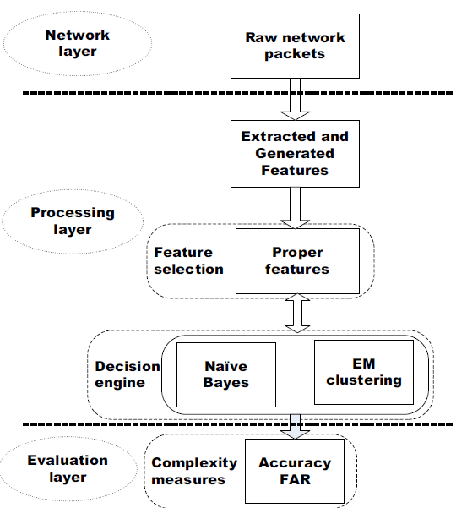
The significant features of the UNSW-NB15 and the KDD99 data sets for Network Intrusion Detection Systems
Association Rule Mining(ARM)
Corrlelation(btn two or more feature)
Evalution:Confusion Matrix(CM)
TP<-Classified attacks(correctly)
TN-Normal Row(correctly)
FP<-missclassified attacks
FN<- Missclassified normal row
Overall accuracy:
accuracy= (TP + TN)/(TP + TN + FP + FN)
NB: Naive Bayes
EM: Expectation Maximaization

